Slide 1

ItsMe: Portable Smart Lock
Hyungseok Yoon, Min JO,
Ivan Chowdhury, Josh Go

Slide 2
Purpose
Project: A portable, attachable smart lock for doors with deadbolt locks.
Catered towards tenants, apartment-users, and frequently moving homeowners.
Main features
Fast, attachment-based installation requires no home renovation.
Open-source, modular design
3D-printable
Other Features
Adjustable to most lock sizes.
Low manufacturing cost
Supports manual and remote unlocking.
Android application: used to monitor and lock/unlock door.

Slide 3
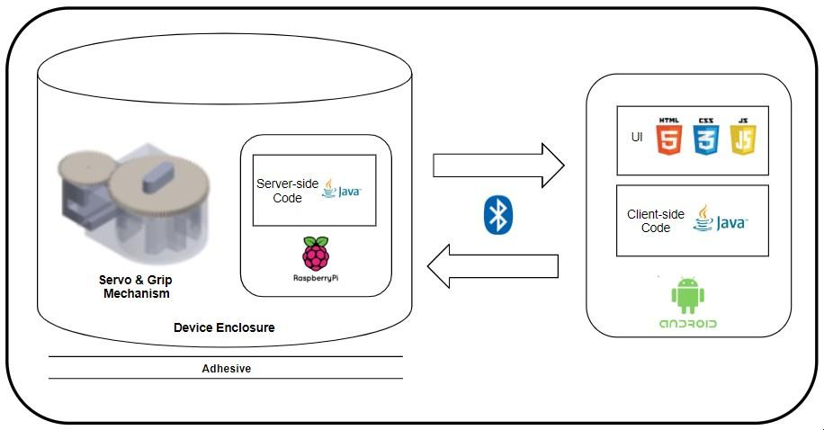
Project Design
App and device communicate via Bluetooth Low Energy
Raspberry Pi and Servo connected directly.
3D-printed gripping mechanism and enclosure.
Double-sided adhesive tape used to attach onto door.

Slide 4
Prototype: Specs
Lightweight:
Gripping mechanism: ~150g
Overall device: ~250g
Manufacturing cost: ~$60.00
Contains slot for Servo motor.
Smooth-fit groove allows for easy fit with multiple deadbolt lock sizes.
Manual lock control supported by rotating knob.

Slide 5
Prototype: Cost of Materials
Material/Process | Cost Estimate
Raspberry Pi Zero W | $10.00
Adafruit Feedback 360° Servo | $27.99
3D-printing (ABS plastic) | $5-10
Strenco 2” Self Adhesive Tape Strips | $13.50
Manufacturing cost: ~$60.00

Slide 6
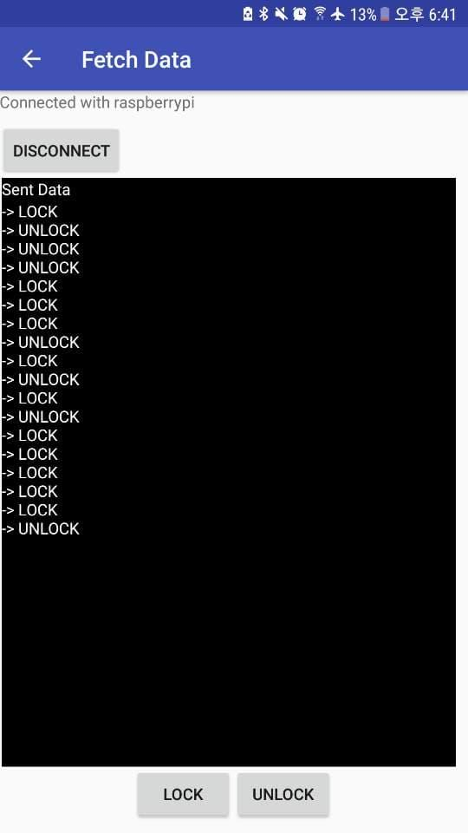
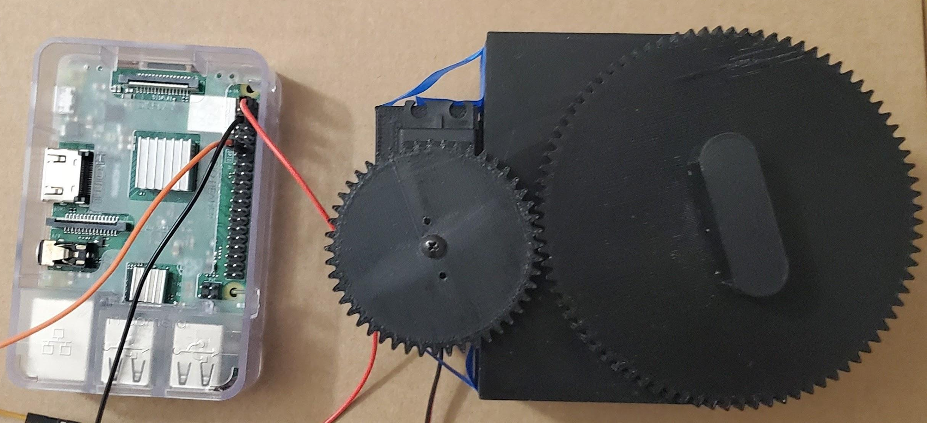
Status Update

Slide 7
Status Update
First device prototype and Android app beta completed.
Core features completed:
3D-printable gripping mechanism with open-source design.
Gripping mechanism supports multiple sizes of deadbolt locks.
Bluetooth compatibility between app and device.
Save the lock status.
Remote locking/unlocking of door.
Low manufacturing cost and lightweight, relative to industry smart locks.
Features that haven’t been completed yet:
Overall device enclosure: Raspberry Pi and Servo/Grip are still separate.
Key sharing features.

Slide 8
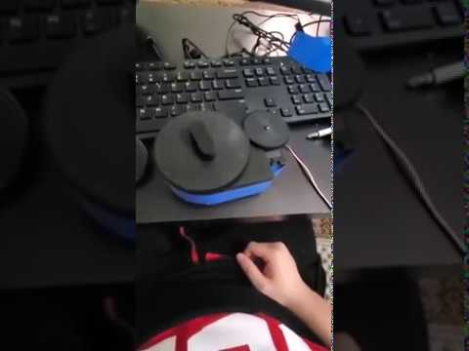
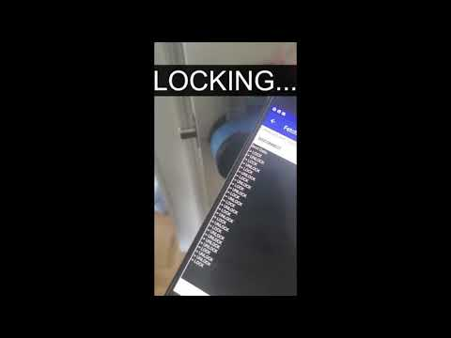
Demo

Slide 9
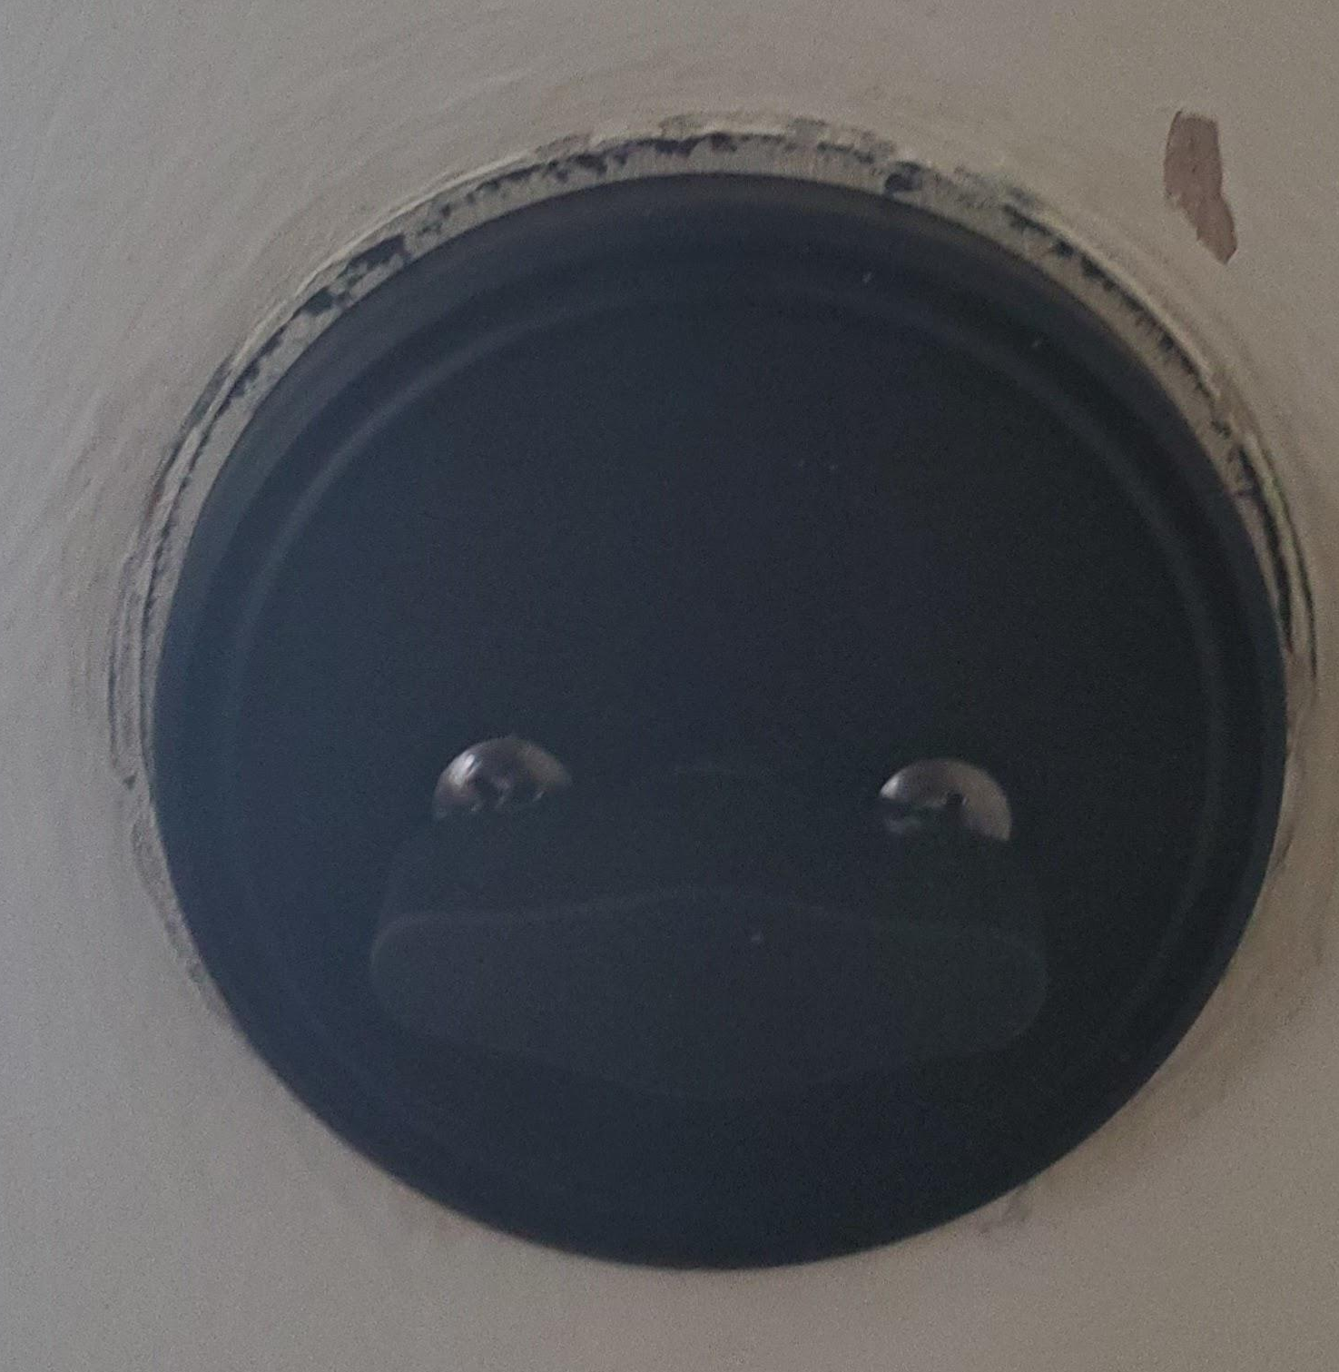
Limitations & Future Work
Only supports deadbolt locks
The material is not hard enough so it is necessary to use harder material + different connecting shape.
Bluetooth Range hasn’t been figured out.
Auto unlock feature when user is out of control for certain length of time is not yet implemented.
Software features that can be added:
3D-printed device ID and registration system.
Various security measures (e.g. 2-factor authentication)

Slide 10


